Slide 1



A cluster-randomised controlled trial, implementing CONn Syndrome screening and Evaluation in Primary care

Slide 2

What is CONSEP?
CONSEP aims to increase screening and diagnosis of primary aldosteronism in people living with hypertension who attend general practice.
Intervention Arm
Screening facilitated with a clinical decision support tool (Guidance Based Requesting - GBR) integrated into Best Practice.
Control Arm
Screening using standard pathology requesting in Best Practice.

Slide 3
  CONSEP- Study Design
Intervention Arm
Control Arm
Best Practice data extraction
Introduction to CONSEP trial and PA screening (20 -30 min)
GBR switch on
GBR user education (20 min- 30 min)
Best Practice data extraction
Introduction to CONSEP trial and PA screening (20 -30 min)
Month 0
Month 3
ARR order and GBR audit
ARR order audit
Month 12
Best Practice data extraction
Practice interview (30 min)
Best Practice data extraction
Month 24
Best Practice data extraction
Best Practice data extraction

Slide 4
  What to do as a participating GP
Who to screen
Minimum x 2 readings of BP ≥ 140/90 (systolic blood pressure ≥ 140 or diastolic blood pressure ≥90)
OR ≥ 4 BP-lowering drugs
Who to refer
ARR ≥ 70 - refer to endocrinologist
ARR ≥ 20 + on interfering medications - refer to endocrinologist
Patient referred back from Endocrinologist: record their diagnosis in Best Practice and keep managing at general practice
Interfering meds:
Diuretic
MR antagonist
ACE inhibitor
Ang II receptor blocker Dihydropyridine calcium channel blocker

Slide 5
  Primary Aldosteronism Diagnostic Pathway
Who to Screen
Results Interpretation
Referral
Confirmation and Sub-Typing
Unilateral
disease
BP ≥ 140/90 (treated or untreated)
ARR >70
Endocrine hypertension service
PA diagnosis
Saline suppression test
Positive
Adrenal vein sampling
Surgery
ARR ≥20
on interfering medication
or
Surgery declined
≥4 BP lowering drugs
Negative
Bilateral disease
ARR <70
not on interfering medication
Mineralocorticoid receptor antagonist
Surgery completed
General practice care
ARR <20
on interfering medication
Measure ARR
Legend
Primary care
Specialist care

Slide 6
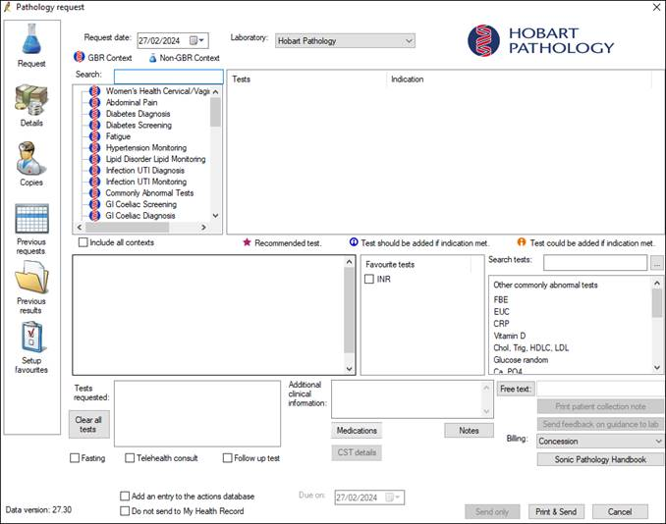
  Ordering ARR – Intervention Arm
Using the GBR Pathology Ordering Window
Select clinical contexts ‘hypertension (diagnosis)’ or ‘hypertension (monitoring)’
Tick ‘renin, aldosterone’
Add additional tests
Print and send

Slide 7


  Crunching the Conn Syndrome Numbers
How many of your patients can you expect to have PA?
Recent research shows that 14% of patients with hypertension have PA
This means for each patient you see with hypertension, 1 in 7 likely have undiagnosed PA
The task now is to find those 1 in 7 patients

Slide 8
Thank you!
Questions?

