Slide 1





Primary aldosteronism
(also known as Conn Syndrome)
A/Prof Jun Yang, MBBS FRACP PhD
Consultant Endocrinologist, Monash Health
Head, Endocrine Hypertension Group, Hudson Institute of Medical Research
Senior Research Fellow, Department of Medicine, Monash University
Jun.yang@Hudson.org.au Twitter: @DrJunYang

Slide 2

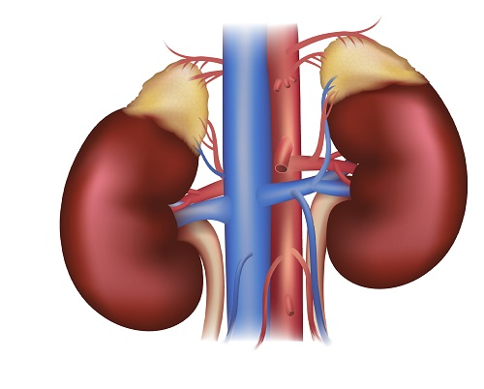
Primary aldosteronism
Autonomous aldosterone production
Mineralocorticoid Receptor (MR)
Renal
Extra-renal
Sodium retention
Hypertension
(±hypokalemia)
↑ CV inflammation & fibrosis
↑ Risk of cardio-metabolic disease
Excess risk decreased by targeted treatment (or cure) of PA
Stowasswer et al, Physiol Rev, 2016
Monticone et al, Lancet Diab Endo, 2018
Turcu A et al, Nature Rev Endo, 2023

Slide 3


Primary aldosteronism is common
Prospective study in GP clinics in Melbourne
  247 previously untreated hypertensive patients, with BP ≥ 140/90 mmHg
  screened by their GP using a blood test (aldosterone to renin ratio, ARR)
  35 (14%) diagnosed with PA
1 in 7 of your patients with hypertension may have PA!
Libianto R et al, MJA, 2022
Notes:
PA is actually the most common curable/treatable cause of HT. Its prevalence varies according to study, but said to be around 10% of all hypertensives and much higher amongst the resistant hypertensives. Prevalence depends on how hard one looks for the condition.

Slide 4
Primary aldosteronism is under-diagnosed
Victorian GP survey:
  Only 1 in 1100 patients were screened for PA
BEACH (Bettering the Evaluation and Care of Health):
  15,000+ GPs and 1.5 million GP-patient encounters (2000-2016)
  Aldosterone test only ordered 66 times
  Only 57 cases of PA identified
Disease considered rare = not tested = not found = rare! (Mark Nelson)
Yang J, Fuller PJ, Stowasser M, MJA, 2018
Nelson M, Editorial, MJA, 2022

Slide 5
Primary aldosteronism is easy to detect
Aldosterone to renin ratio (ARR) = screening blood test
WHAT IT IS
relative amount of aldosterone to renin →in health, rise and fall together
In primary aldosteronism, aldosterone is normal or high, while renin is low → ARR high
INTERPRETATION
ARR ≥ 70 (in most labs)
ARR ≥ 20 if on interfering medications (which increase renin)
Higher ARR = higher likelihood of primary aldosteronism
Interfering meds:
Diuretic
MR antagonist
ACE inhibitor
Ang II receptor blocker Dihydropyridine calcium channel blocker
Gurgenci T et al, AJGP, 2020

Slide 6
  Diagnostic Pathway
Who to Screen
Results Interpretation
Referral
Confirmation and Sub-Typing
Unilateral
disease
BP ≥ 140/90 (treated or untreated)
ARR >70
Endocrine hypertension service
PA diagnosis
Saline suppression test
Positive
Adrenal vein sampling
Surgery
ARR ≥20
on interfering medication
or
Surgery declined
≥4 BP lowering drugs
Negative
Bilateral disease
ARR <70
not on interfering medication
Mineralocorticoid receptor antagonist
Surgery completed
General practice care
ARR <20
on interfering medication
Measure ARR
Legend
Primary care
Specialist care
How can we increase screening in primary care? → CONSEP

Slide 7
Thank you!
Please send questions to consep@monash.edu

